Slide 1

Online Student Course Registration System

Slide 2
WORK ALLOCATION TO TEAM MEMBERS
S.NO | ROLL NO | NAME | DIVISION OF WORK
1. | 2110030345 | B.AKSHAYA | Communication, SRS
2. | 2110030412 | U.YESASHWINI | planning, testing
3. | 2110030426 | P.SUBHATHISH | Modelling, review
4. | 2110030444 | K.DHANA SREE | Development, maintenance

Slide 3
PROJECT REQUIREMENTS
User requirements
Course registration system with less manual work.
An instructor to instruct the students and clear doubts if any.
Easy to use and less time-consuming application.
A feedback form for students.
System requirements
Front end
Python and HTML
Back-end
Data Base Management System
Software Engineering
To analyze the needs and requirements of users to design, develop, deploy, and test new software.

Slide 4
LITERATURE REVIEW
https://www.academia.edu/3410337/Challenges_of_Students_Online_Registration_System
https://www.ijert.org/research/an-implimentation-of-an-online-based-registration-system-in-tertiary-institutions-in-zimbabwe-IJERTV2IS100988.pdf
https://www.ukessays.com/essays/computer-science/online-course-registration-and-management-system-computer-science-essay.php

Slide 5
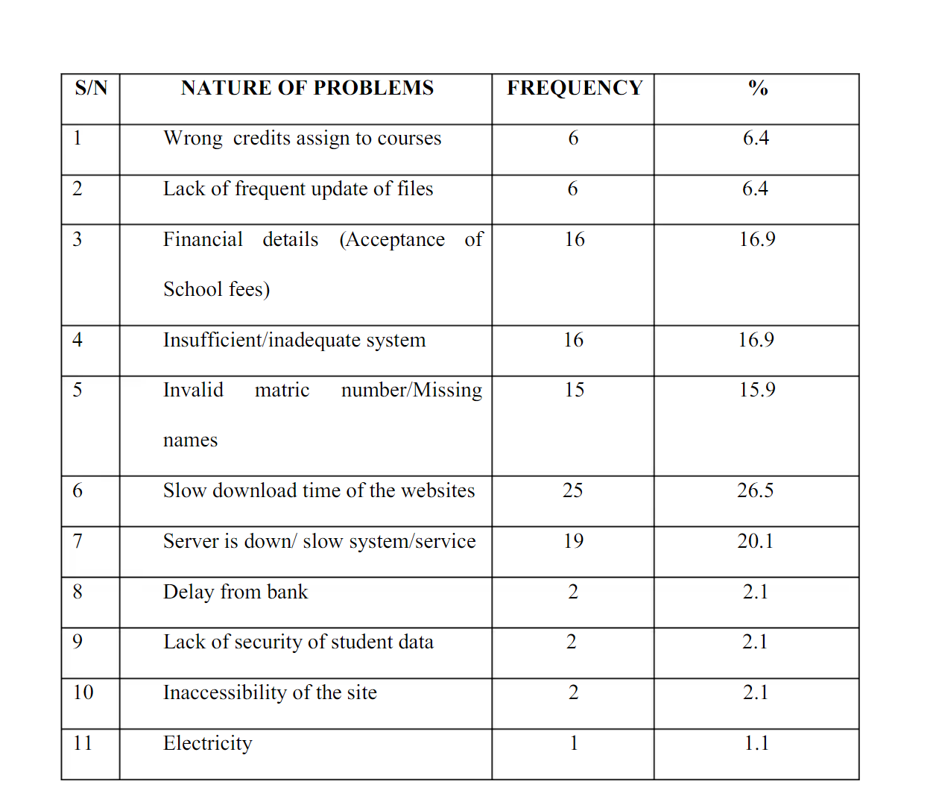
LITERATURE REVIEW
Statistics of issues faced in many universities

Slide 6
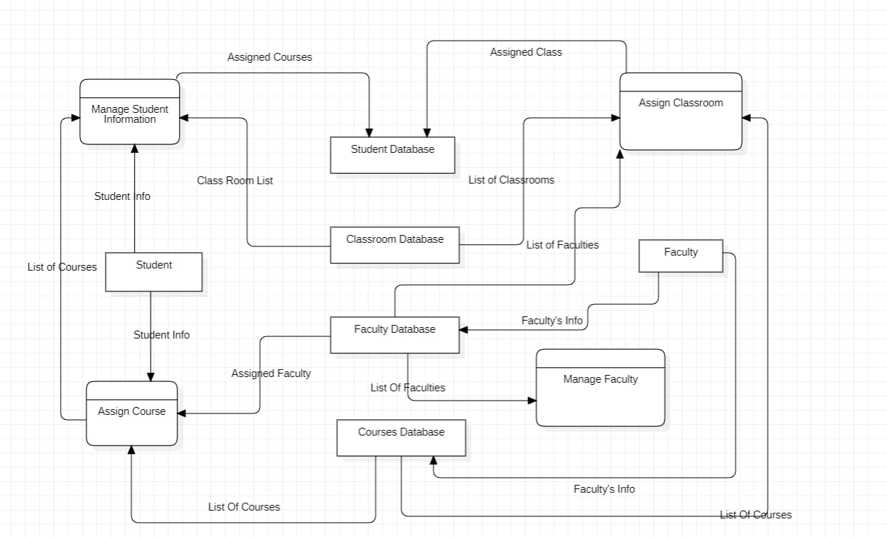
DATA FLOW DIAGRAM

Slide 7
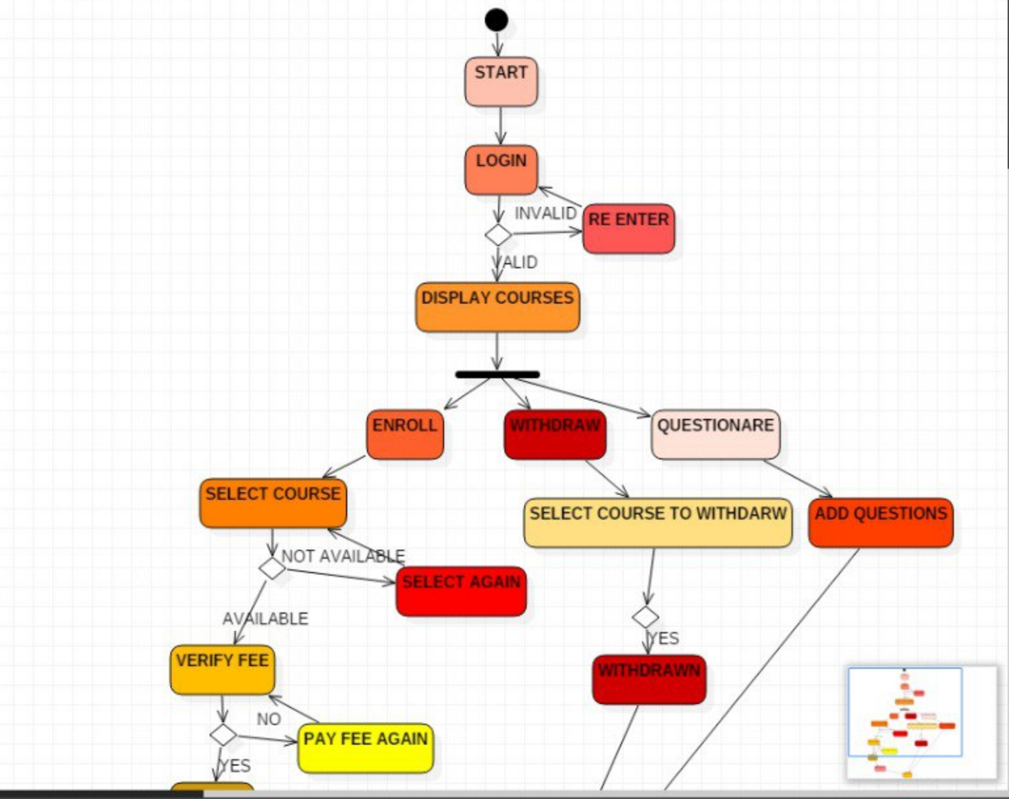
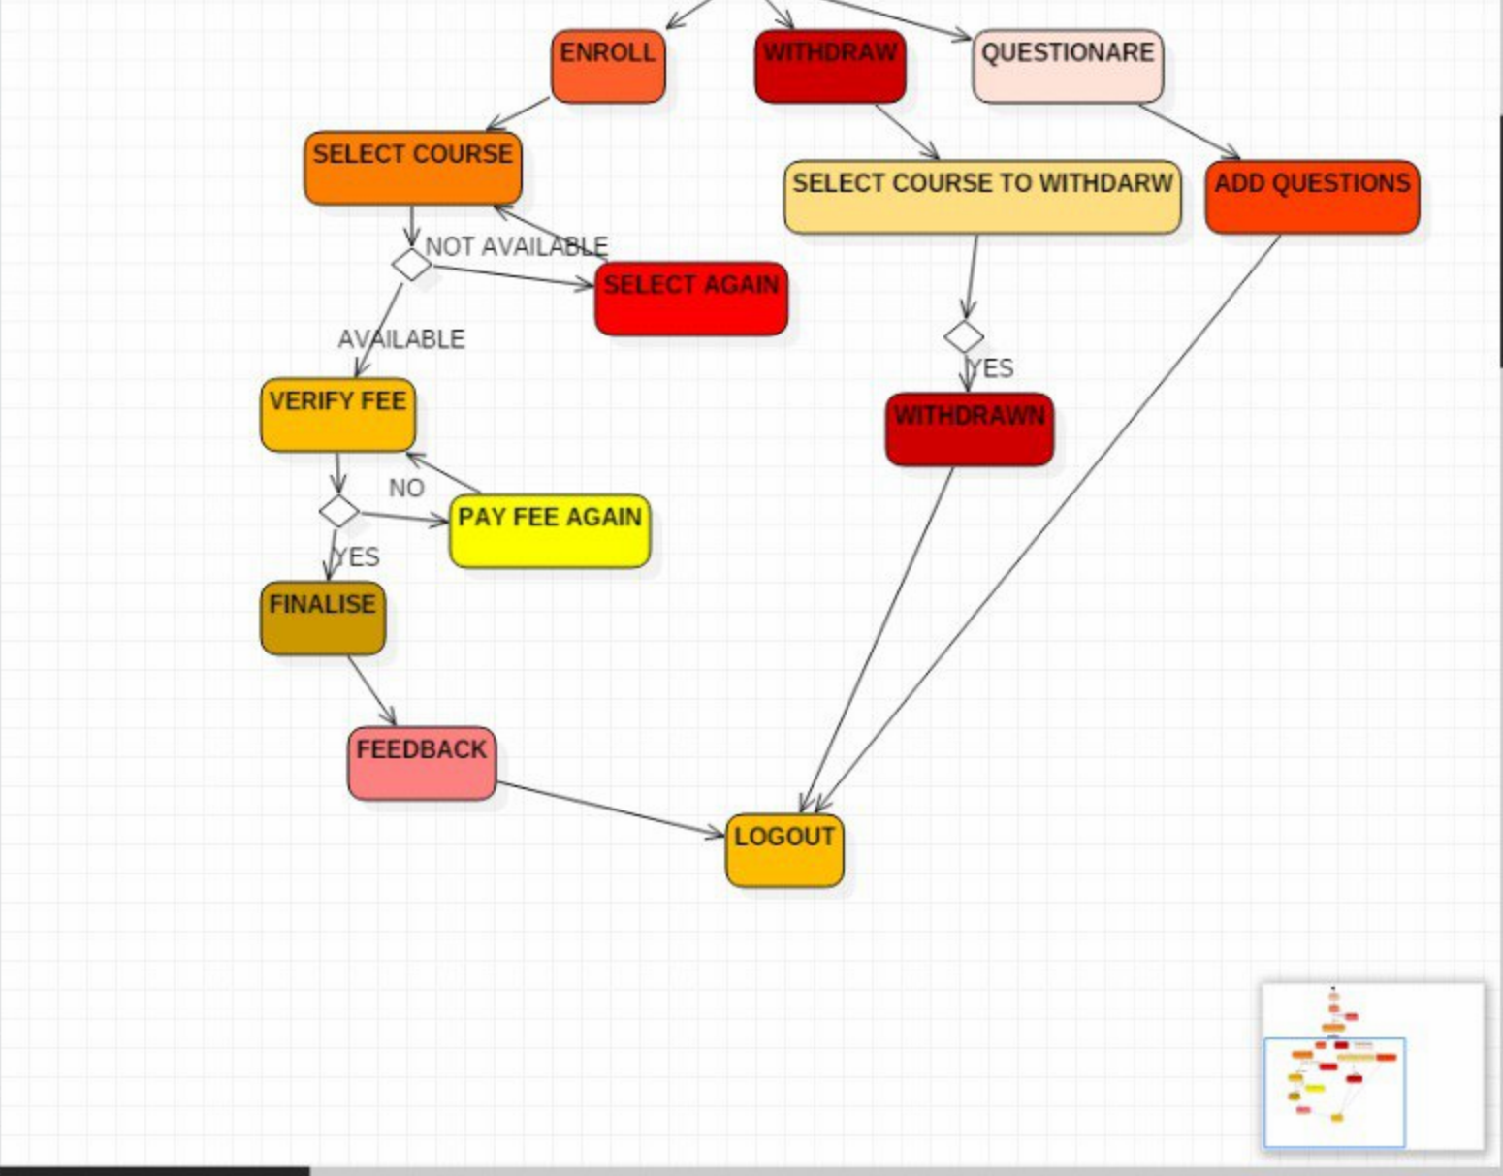
IMPLEMENTATION OF FLOW CHART

Slide 8
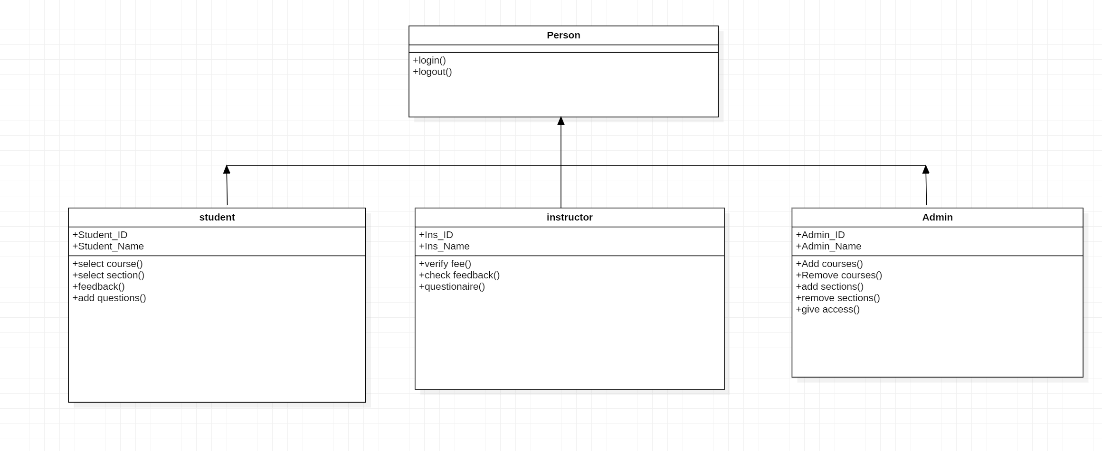
CLASS DIAGRAM

Slide 9
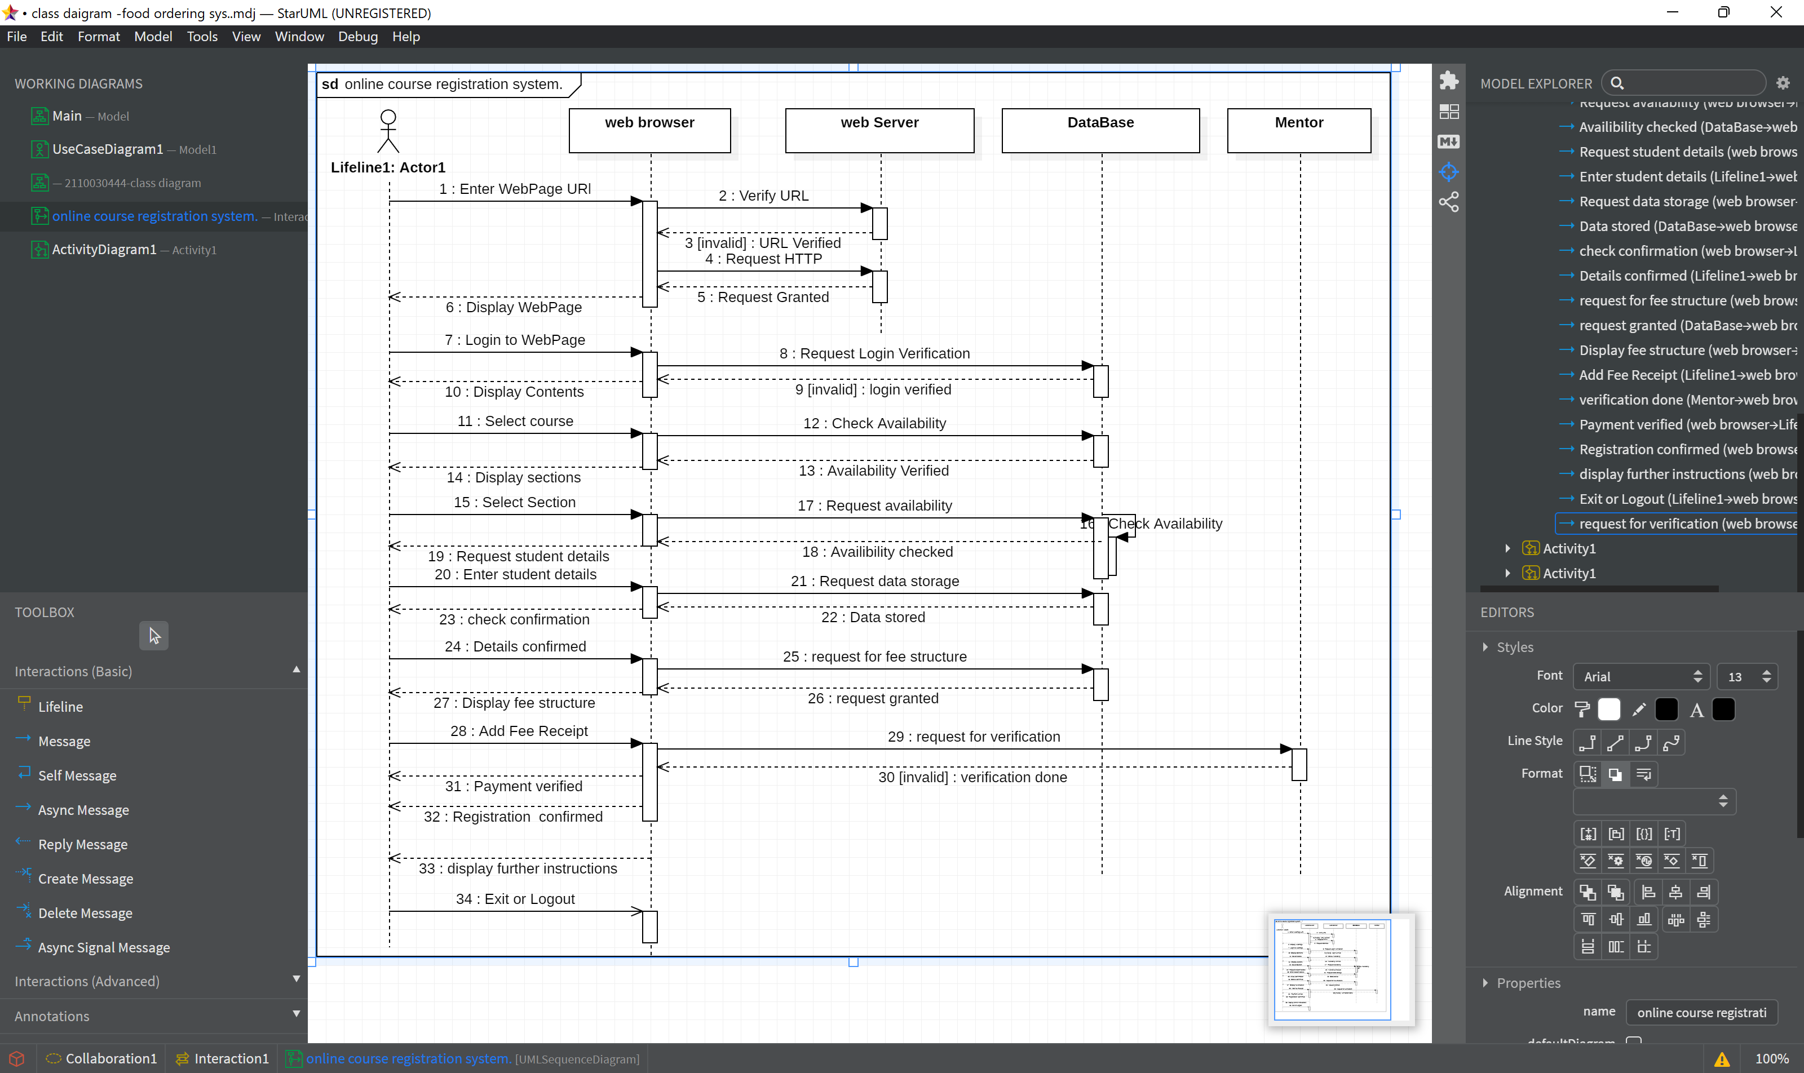
SEQUENCE DIAGRAM

Slide 10
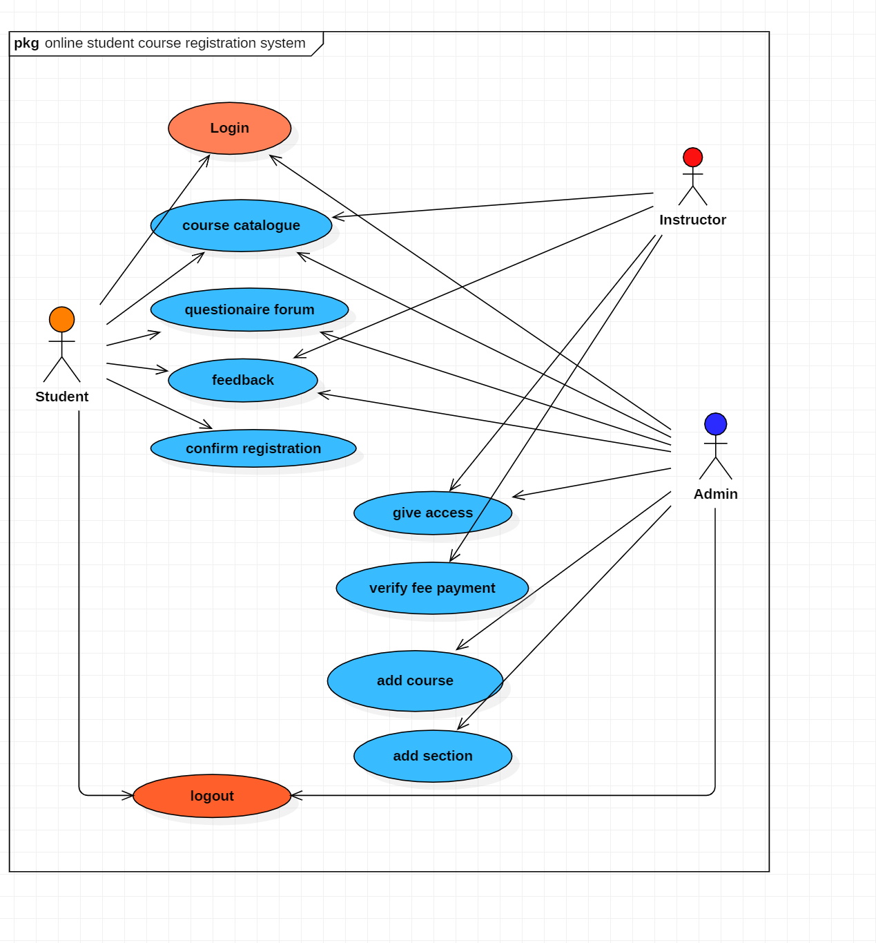
USE CASE DIAGRAM

Slide 11

TOOLS SETUP
HARDWARE REQUIREMENTS:-
PROCESSOR:- Intel core i3 3220 or Amd Ryzen 3 2300U
RAM:- 4GB(minimum)
HARD DISK:- 500 GB
PLATFORM :- Windows 8/10/11 64 bit
SOFTWARE REQUIREMENTS:-
Star UML - It is a software engineering tool for system modeling using the Unified Modeling Language, as well as Systems Modeling Language, and classical modeling notations. It is published by MKLabs and is available on Windows, Linux and MacOS.
Terra ER - An open-source modeling tool designed to support students in the creation of ER models that reflect exactly the data modeling concepts learned in the classroom."
EDITORS - PYCHARM IDE./Eclipse Version: 2021-06 (4.20.0)
PYTHON 3.8 - Python is an interpreted high-level general-purpose programming language
DATABASE-SQL - is a special-purpose programming language designed for managing data in relational database management systems.

Slide 12
TOOLS SETUP
Flask
Flask is a lightweight Python web framework that provides useful tools and features for creating web applications in the Python Language.
MySQL
MySQL is a database management system.
MySQL is ideal for storing application data in multiple tables, specifically web application data.
PyCharm
PyCharm is a dedicated Python Integrated Development Environment (IDE) providing a wide range of essential tools for Python developers, tightly integrated to create a convenient environment for productive Python, web, and data science development.

Slide 13
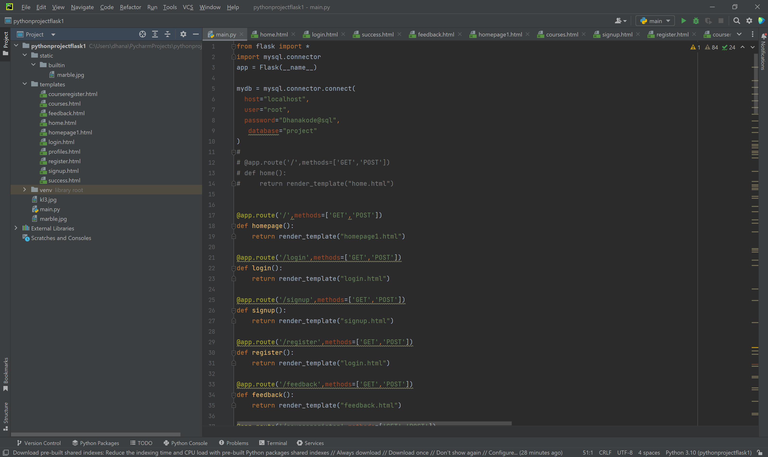
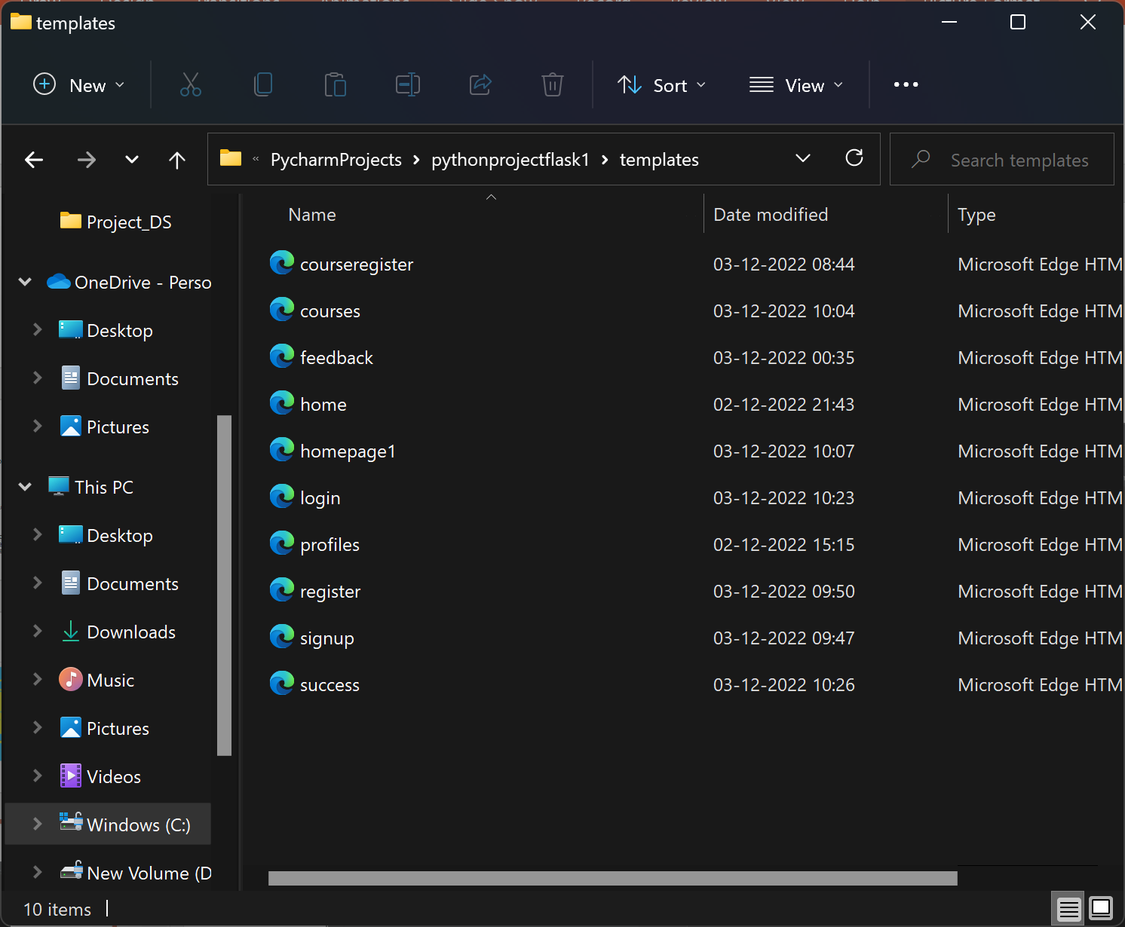
IMPLEMENTATION

Slide 14

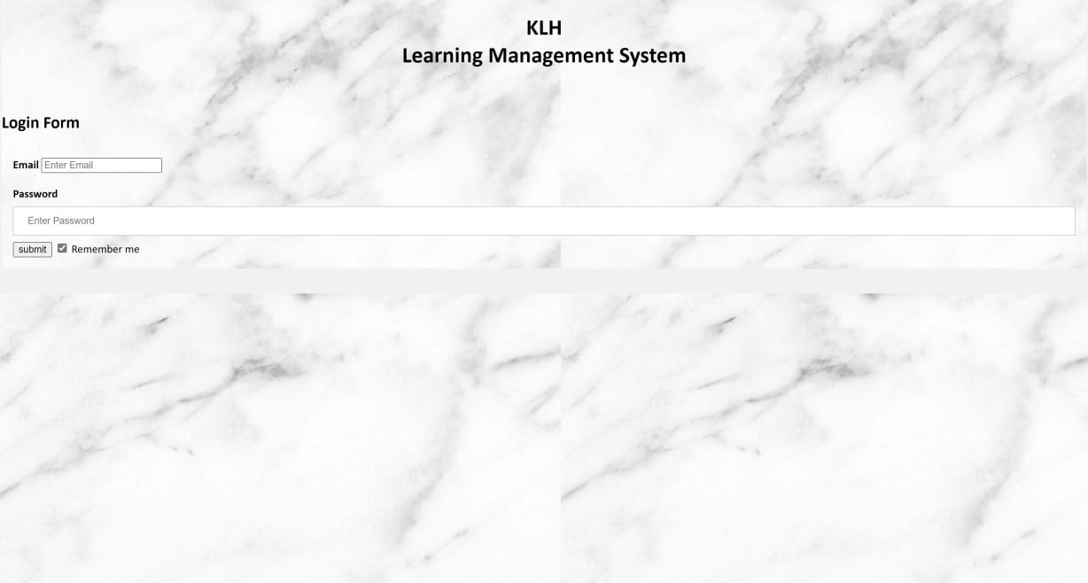
FINAL OUTPUT

Slide 15
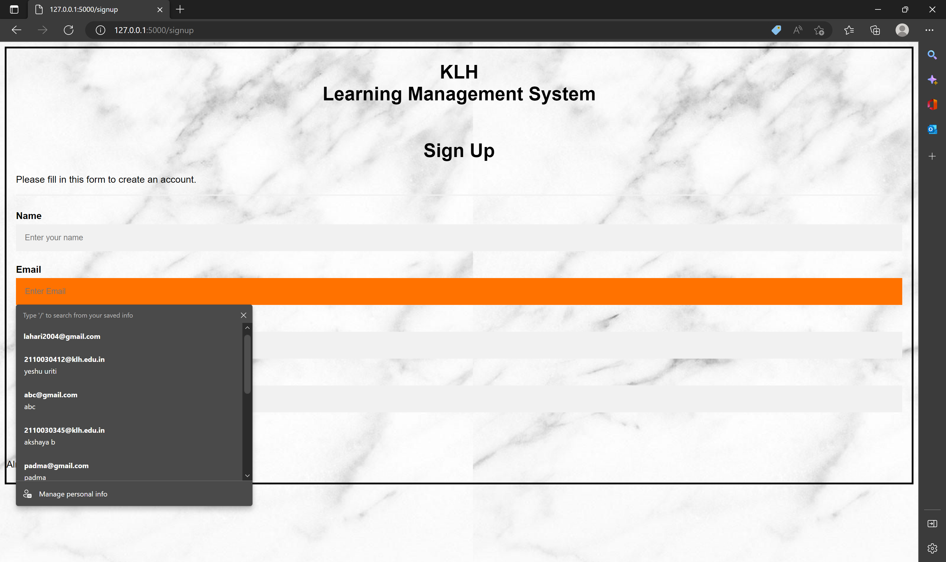

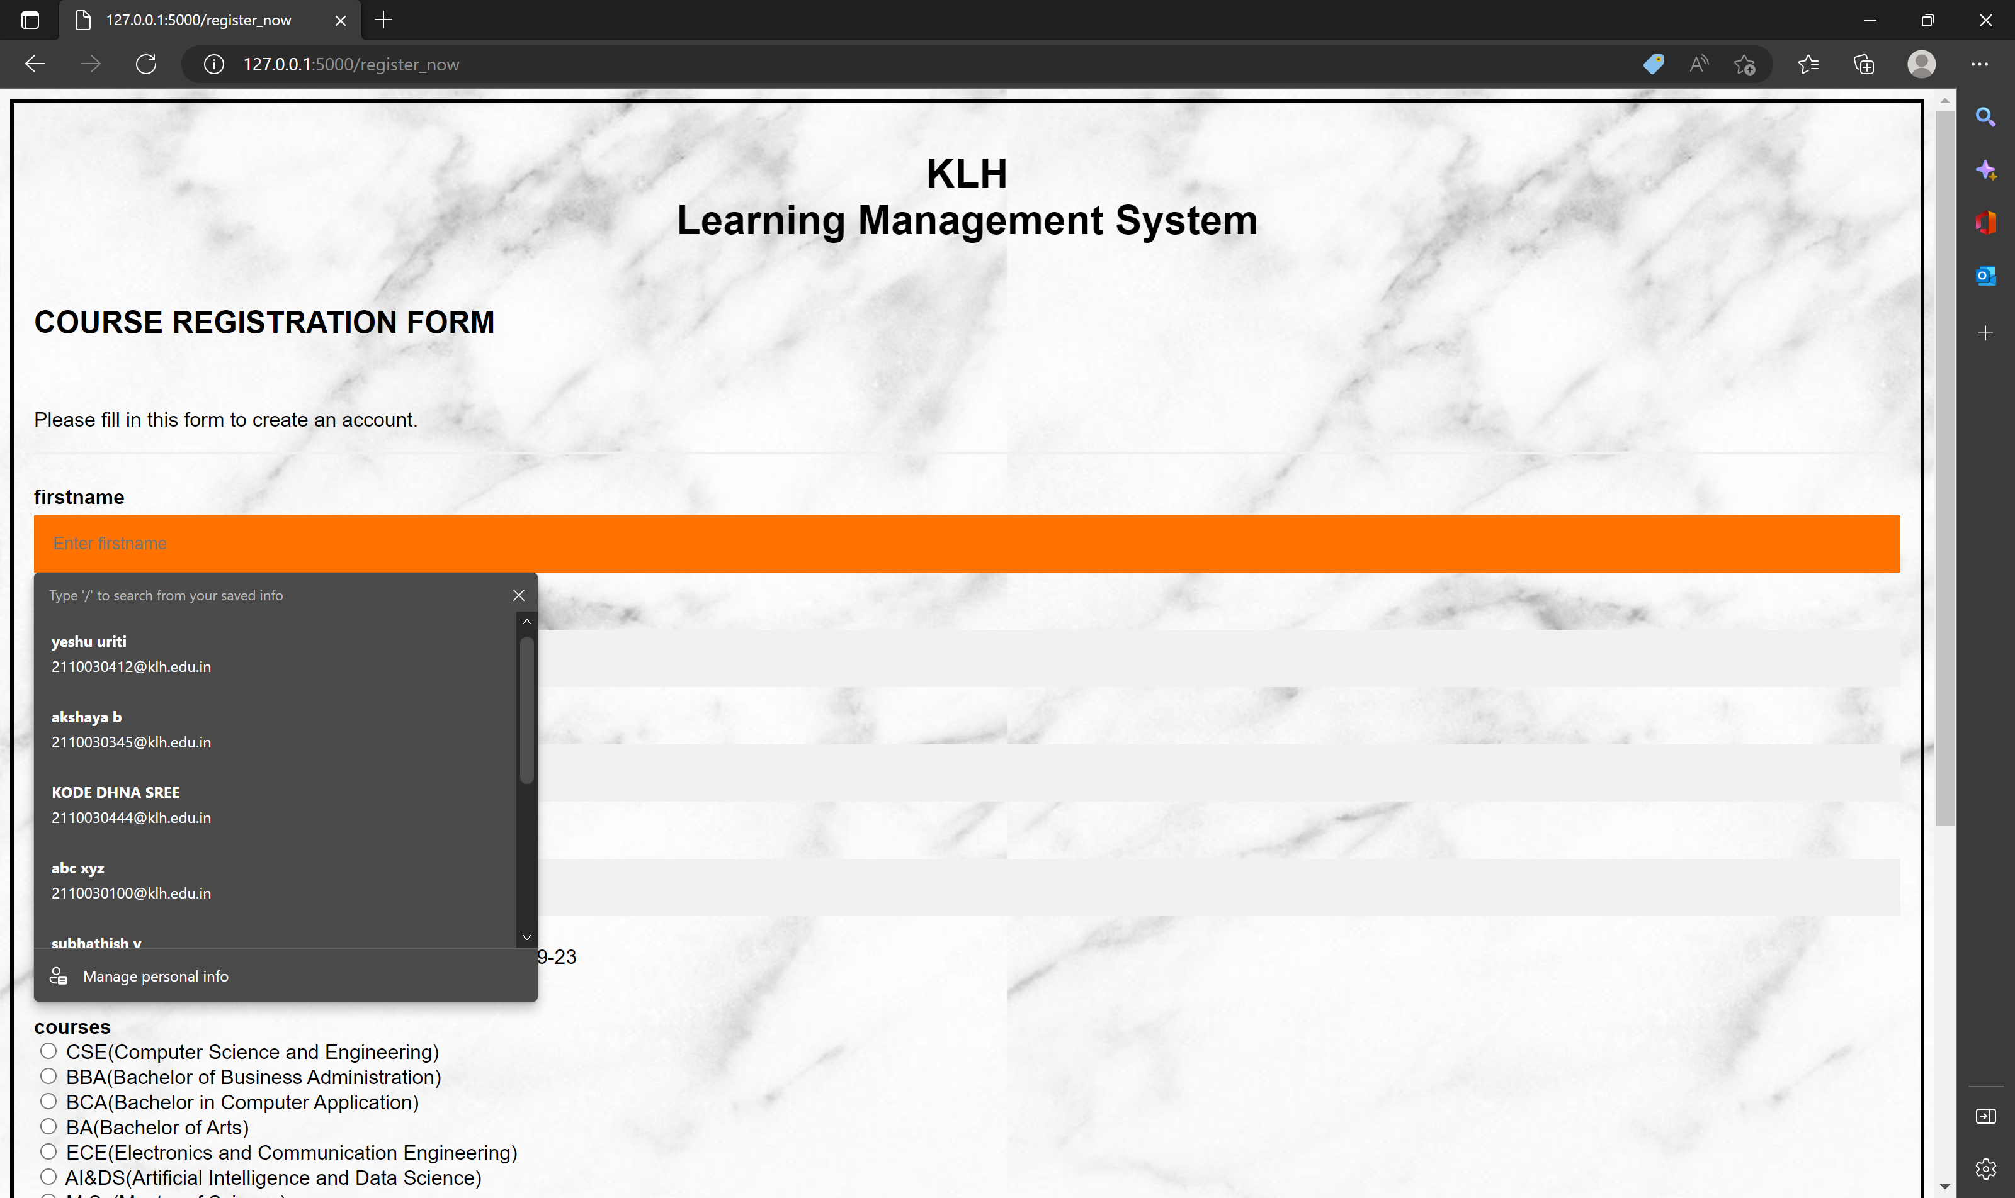

Slide 16
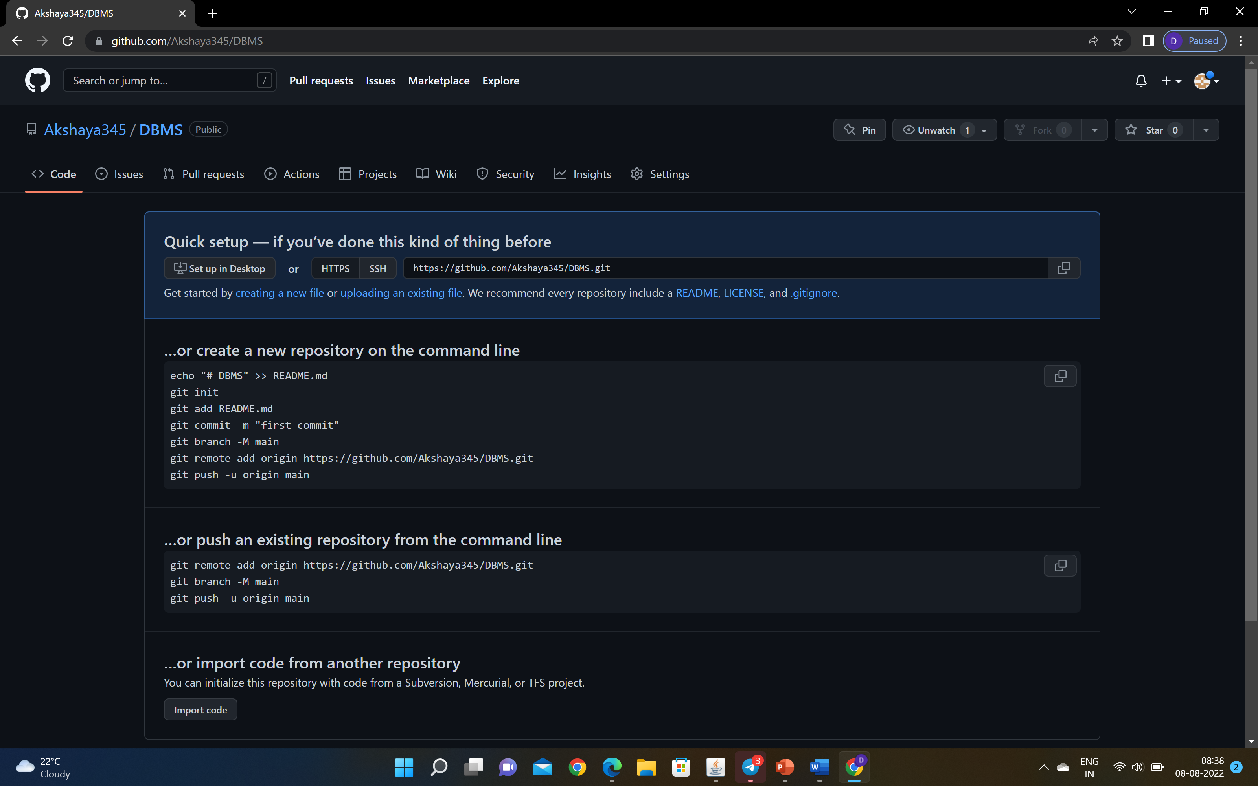
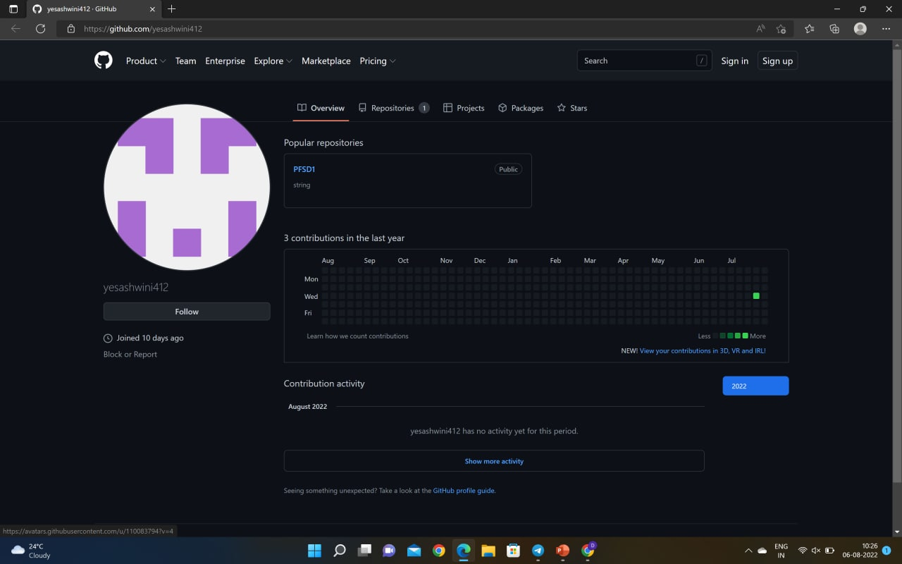
GITHUB SETUP

Slide 17
